Slide 1

CIAM Solution Integration with Applications
Secure, Scalable, and Seamless Access for All Users
Presented By : CIAM Team Date : 23 July 2025

Slide 2
Objective
To explain how CIAM with SSO will be integrated with internal and external applications.
To showcase the authentication flows and supported protocols.
To define roles, responsibilities, and benefits.
What is CIAM?

Slide 3
CIAM Overview
Centralized identity platform for external users
Api based Invitation Link and password reset
Secure authentication (MFA, OTP, Biometrics)
Consent & privacy management
User & Device management
Scalable to thousands of users
Access Management through RBAC,ABAC policy
CIAM

Slide 4

Why SSO in CIAM?
Benefits of SSO Integration
Seamless access across applications
Reduced login friction
Centralized user management
Lower IT overhead
Enhanced security posture
Application wise login journey and branding customization

Slide 5

Protocol Support
SAML2.0 Web SSO
OAuth2 Authorization Code / Resource Owner/ Client Credentials / Refresh Token / Device Authorization
Authorization using XACML
OpenID Connect for modern apps
SCIM for user provisioning
FIDO2/WebAuthn if MFA is included
Push notification
SCIM for user provisioning/de-provisioning

Slide 6
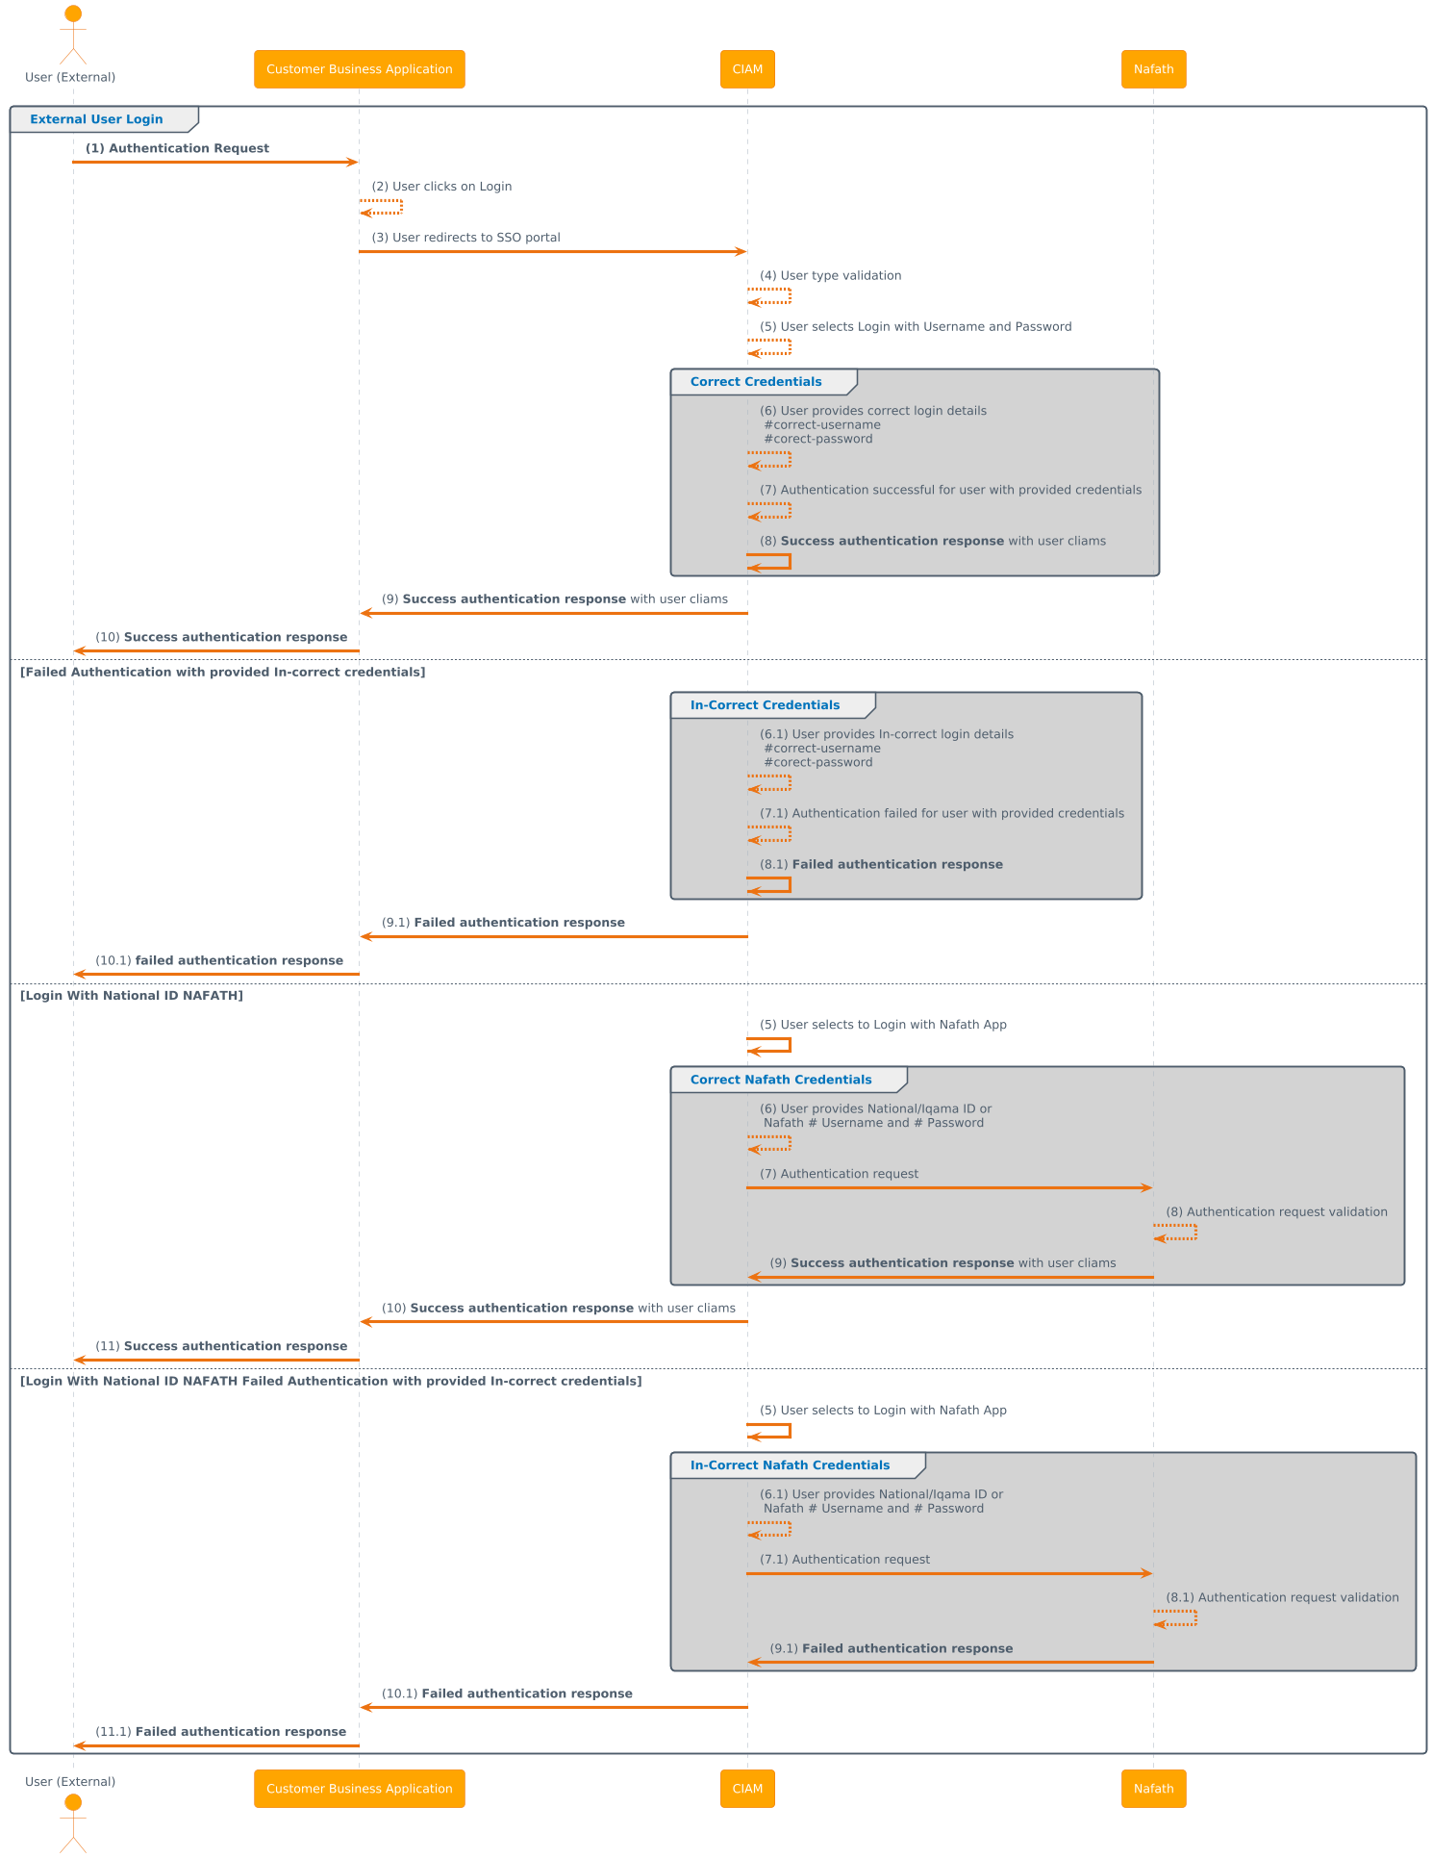

Slide 7
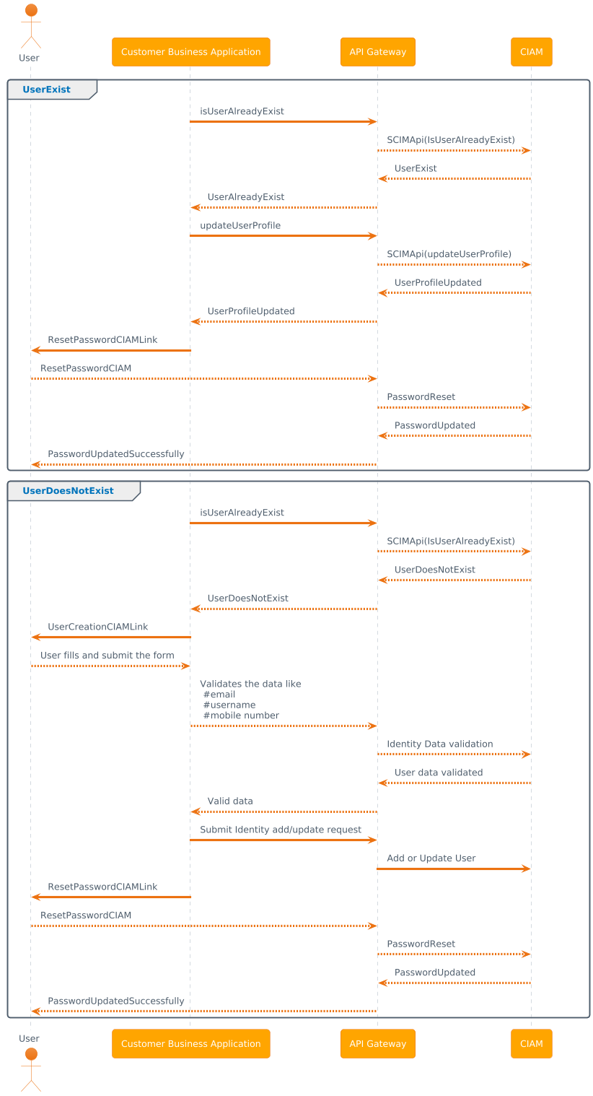
User On-Bording/Provisioning

Slide 8
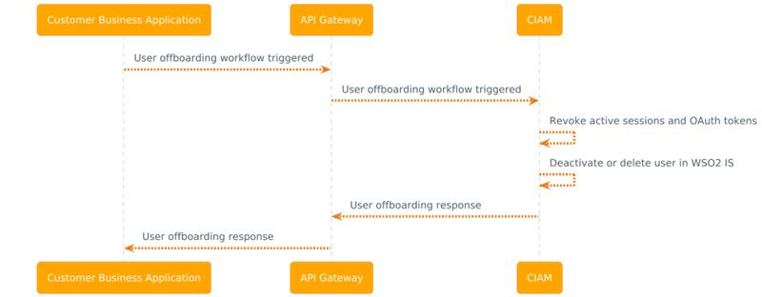
User Off-Bording/De-Provisioning

Slide 9
Q&A

